Slide 1
Scrum Project planning
Elaborated by Samar Jberi
1

Slide 2
Main stages of every Sprint
01
02
03
04
Plan
Build
Test
Review
2

Slide 3


Our team
Product Owner
Scrum Master
Developer
Sekri Ismail
Jerbi Oussema
Jberi Samar
3

Slide 4
Product backlog
Dynamic Norms update.
Creation of smart search engine.
Advanced search filters.
User access management.
Manage the approval of adding new documents.
4

Slide 5
Next
Sprint planning
In this phase we should select the top priority sprint story
5

Slide 6
Dynamic Norms update
As a user I need a dynamic system update so I can work on the different yet most updated files
Connect to the share point.
Loop through the different files stored in the share point.
Have access to the content of each file.
Sprint backlog
Start
End
06/04/2022
Schedule
06/05/2022
20/05/2022
6

Slide 7
Creation of a smart search engine
As a user I need a smart search engine so I can work on the different yet most updated files on the share point
Specify different treatment for every file format ( PDF, Excel , Word).
Search for an input within the files.
Apply text mining to the text and search for the optimal matching files.
Return the exact location and heading of the input.
Display the file from the sharepoint.
Sprint backlog
Start
End
06/04/2022
Schedule
20/05/2022
03/06/2022
7

Slide 8
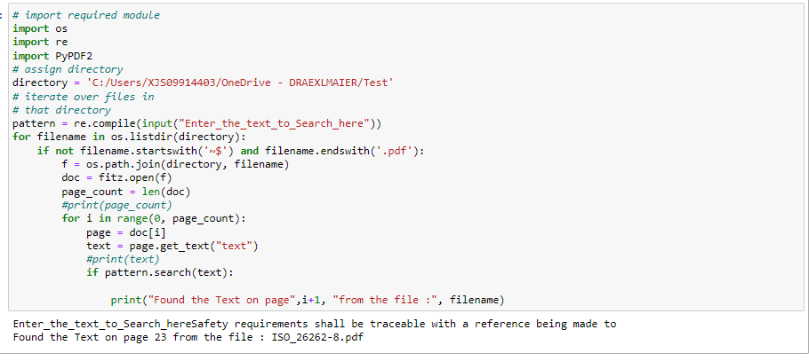
Creation of a smart search engine
Searching within pdf Sample
8

Slide 9
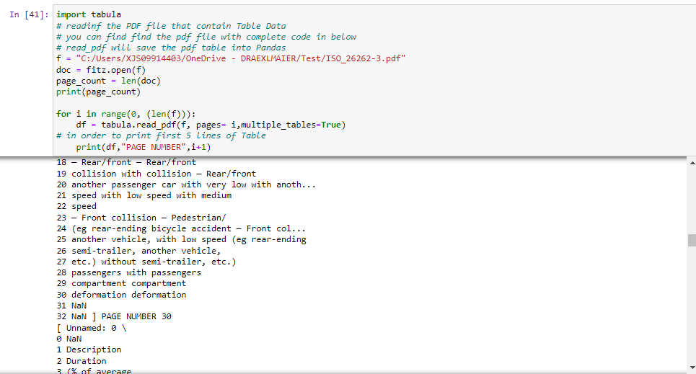
Creation of a smart search engine
PDF Table extraction
9

Slide 10
Thanks
13

Slide 11
Advanced search filters
As a user I need advanced filters so I can filter the results.
Sprint backlog
Choose file format(PDF, Word, Excel).
Chose the type of norms ( ISOxx).
Start
End
06/04/2022
Schedule
03/06/2022
21/06/2022
10

Slide 12
User access management
As a user I need to login or Sign-up so I access the application
Create a sign in GUI.
Create a sign-up GUI.
Create a reset password GUI.
Create an approval system managed by the administrator for the signed-up users.
Create the rest of the GUI and link it to the program.
Sprint backlog
Start
End
06/04/2022
Schedule
21/06/2022
10/07/2022
11

Slide 13
Manage the approval of adding a new document
As an adiministrator user I need to manage the approval of adding new documents to the sharing point so I can ensure security and integrity.
Sprint backlog
Create a document view GUI.
Display the content of the sharing point.
Add document request.
The request is to be sent to the administrator for approval.
Start
End
Schedule
10/07/2022
24/07/2022
12

